Slide 1



Building a Recipe Generator
This project explores how to create a recipe generator that uses AI to produce creative and practical cooking recipes based on given ingredients.

Slide 2


Defining the Project Objective
The goal is to develop a system that can reliably generate cooking recipes using specific ingredients as input. The generated recipes should be diverse, flavorful, and tailored to user preferences and dietary needs.

Slide 3
Identifying Key Ingredients for Recipes
Common Ingredients
Specialized Ingredients
Dietary Restrictions
Staples like chicken, beef, rice, vegetables, and herbs form the foundation of many recipes.
Exotic spices, seafood, grains, and plant-based proteins can add unique flavors and textures.
Accommodating vegan, gluten-free, or other dietary needs expands the recipe possibilities.

Slide 4

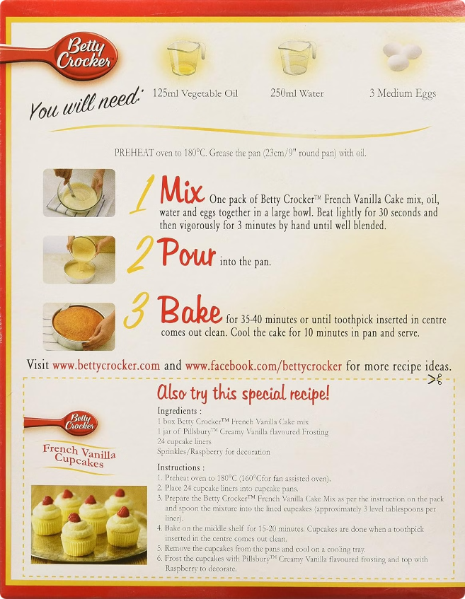
Structuring Prompts for Recipe Generation
1
Clear Ingredient List
Provide a specific set of ingredients to focus the AI's recipe generation.
2
Flavor Profiles
Suggest cuisines, cooking styles, or flavor combinations to guide the recipe.
3
Dietary Requirements
Indicate any dietary restrictions or preferences to tailor the recipe.
4
Optional Instructions
Include preparation steps, cooking methods, or serving suggestions to refine the output.

Slide 5


Techniques for Guiding the AI to Desired Outputs
1
Iterative Refinement
Start with a broad prompt, then provide feedback to gradually improve the recipe.
2
Prompt Engineering
Carefully structure the prompt to encourage specific recipe attributes or cooking methods.
3
Model Finetuning
Retrain the AI model on a curated dataset of high-quality recipes to enhance its outputs.

Slide 6

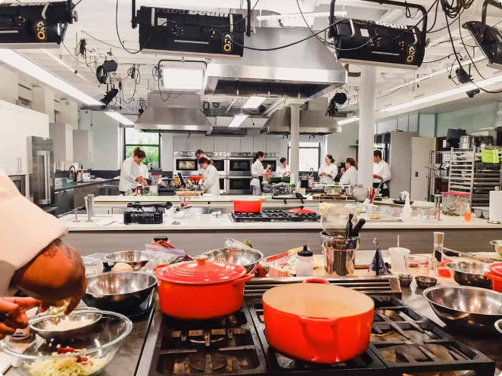
Ensuring Reliability and Practicality of Generated Recipes
Ingredient Compatibility
Verify that the selected ingredients work well together and create a balanced dish.
Preparation Instructions
Provide clear and detailed steps for preparing the recipe, including cooking times and temperatures.
Nutritional Information
Analyze the recipe's nutritional profile to ensure it meets dietary guidelines and preferences.
Taste and Presentation
Test the recipe and refine it to achieve the desired flavor, texture, and visual appeal.

Slide 7


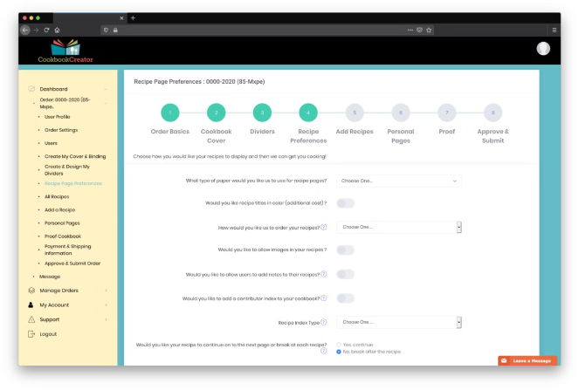



Incorporating User Preferences and Dietary Restrictions
Vegetarian
Offer plant-based recipes that exclude meat, poultry, and seafood.
Gluten-Free
Develop recipes that use gluten-free ingredients and avoid wheat, barley, and rye.
Low-Calorie
Provide nutrient-dense, low-calorie options for health-conscious users.
Dairy-Free
Create dairy-free recipes using non-dairy substitutes like plant-based milks.

Slide 8





Optimizing Prompts for Diverse Recipe Types
Cuisine Specific
Tailor prompts to generate recipes from various cultural traditions, such as Italian, Mexican, or Thai.
Meal Types
Prompt for specific meal categories, like appetizers, main dishes, desserts, or side dishes.
Ingredient Combinations
Experiment with unique ingredient pairings to inspire novel and creative recipe ideas.

Slide 9


Evaluating and Refining the Recipe Generator
Metric
Description
Target
Accuracy
How closely the generated recipes match the input prompts
90%
Diversity
The range of unique recipe types and flavor profiles produced
High
Practicality
The feasibility and ease of preparing the generated recipes
90%
User Satisfaction
Feedback from users on the quality and usefulness of the recipes
High

Slide 10


Conclusion and Next Steps
The recipe generator project has demonstrated the potential for AI to inspire creative and practical cooking ideas. By carefully structuring prompts and refining the model, we can produce a diverse range of high-quality recipes tailored to user preferences. Moving forward, integrating the generator into a user-friendly application and continuously improving its capabilities will be key to its success.

